Slide 1
Climate-Smart Land Trusts
Marian Vernon
Sierra Meadow Adaptation Leader
March 6, 2018
Notes:
Introduce myself
PB views this as an opportunity to take the great work land trusts are doing and use them as an important climate change conservation tool.
Introduce Point Blue’s work on climate-smart land trusts
Demonstrate how climate-smart principles can be adapted for land trusts
Get feedback on approach
Questions to ask audience at start/throughout:
Are you concerned about climate change impacts to your protected lands?
Have you taken steps to integrate climate change into strategic conservation planning?
Have you changed how you craft CEs to ensure conservation values on eased lands will be protected in perpetuity under climate change?
Have to altered stewardship activities to adapt to climate change impacts?
Have you monitored conservation values on protected lands to see if they are being impacted by climate change or other stressors?
WIFL
TomKat Cattle Grazing
SacValley Rice field

Slide 2
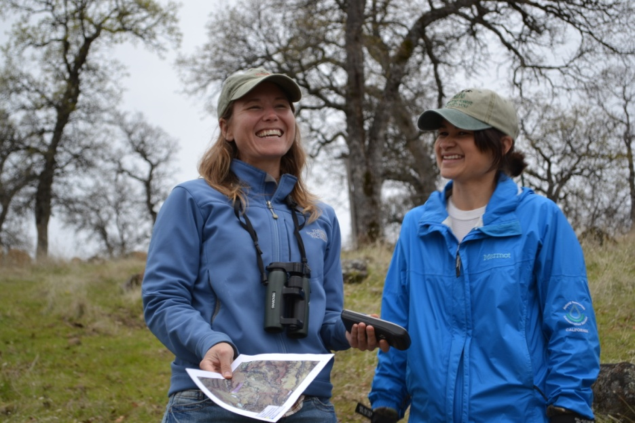
Point Blue
Working to reduce impacts of environmental change and develop nature-based solutions for people and wildlife.
Founded in 1965
Based in Petaluma, CA
Work on conservation of terrestrial and marine ecosystems
140+ staff and seasonal scientists
Climate-Smart Land Trusts
Notes:
Focusing on climate change and climate-smart conservation
Increasing pace and scale of climate-smart conservation – land trusts are essential partners in this work
See land trusts as having huge potential to advance climate-smart conservation and have a big impact on conservation in CA

Slide 3
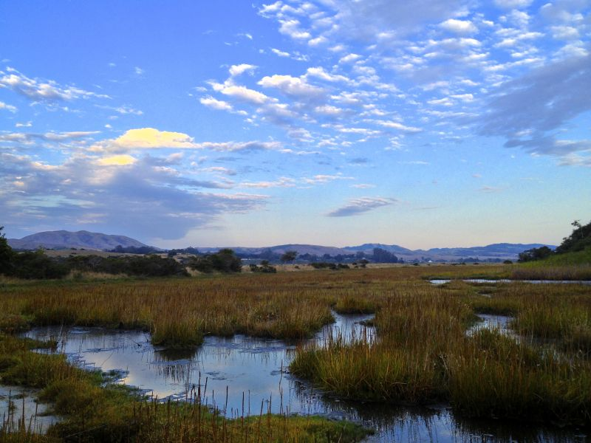
What role can your land trust play in combating climate change?
Land plays a role in mitigation and adaptation
Nimbleness and flexibility to test innovative solutions
Living laboratories
Protecting and restoring tidal marshes can help buffer against sea level rise and sequester carbon.
Notes:
Huge potential for land trusts to use your land protection and stewardship activities for mitigation and adaptation
Private land is so important and has so much potential, even more so now that public lands and federal government funds are limited
Land trusts’ superpowers include nimbleness and flexibility – can use these skills to test innovative solutions and climate smart concepts
Can use preserves as living laboratories to monitor climate change impacts on resources and test stewardship actions to reduce vulnerabilities
Land trusts, private lands, flexibility all important as federal priorities shift, private land more important than ever
Close-knit community and land trust network means that land trusts have the potential to share their experiences with others and apply solutions to the broader landscape

Slide 4
What would climate-smart land trusts look like?
Strategic Conservation Planning
Project Selection
Acquisition (Fee or CE)
Stewardship
Monitoring and Evaluation
Notes:
Make each step climate smart
Build stewardship capacity
Adaptive Management is crucial
For the rest of the presentation, I’ll walk you through each step of this process with examples about how to make it climate smart

Slide 5
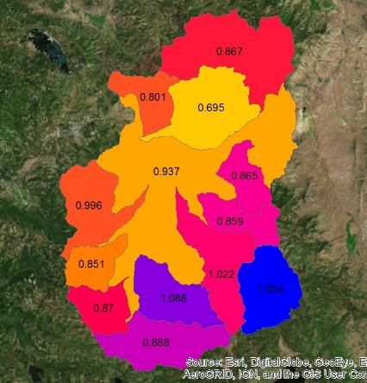
Strategic Conservation Planning
Incorporate future climate to:
Reevaluate priorities & goals
Prioritize acquisitions
Identify vulnerabilities
Feather River Land Trust: projections of climatic water deficit- runoff & groundwater recharge- to prioritize potential easement acquisitions; blue watersheds prioritized to secure greatest water resources
Yellow= more CWD Blue= less CWD by 2070
Notes:
Consider how climate change will impact what you care about
Need to reconsider priorities and goals
Prioritize acquisitions by being future-focused and strategic
Example: Sierra Valley, working with FRLT to provide climate projections to help guide prioritization of easement acquisitions for these wet meadow ecosystems
Map shows predicted changes in CWD (runoff and recharge) comparing 2010 to 2070. Uses BCM, 270m grid resolution, free data – downscaled to level of decision-making
Cooler colors show increases and warmer colors show decreases over time for each watershed in the valley
Prioritize watersheds that will continue providing water recharge and water supply benefits in the future
Beyond just looking at maps like this, brainstorm the range of possible climatic changes and the potential vulnerabilities to the resources you care about
If you have a fee property in a watershed likely to experience declines in water availability, think about management actions you can take to reduce vulnerability

Slide 6
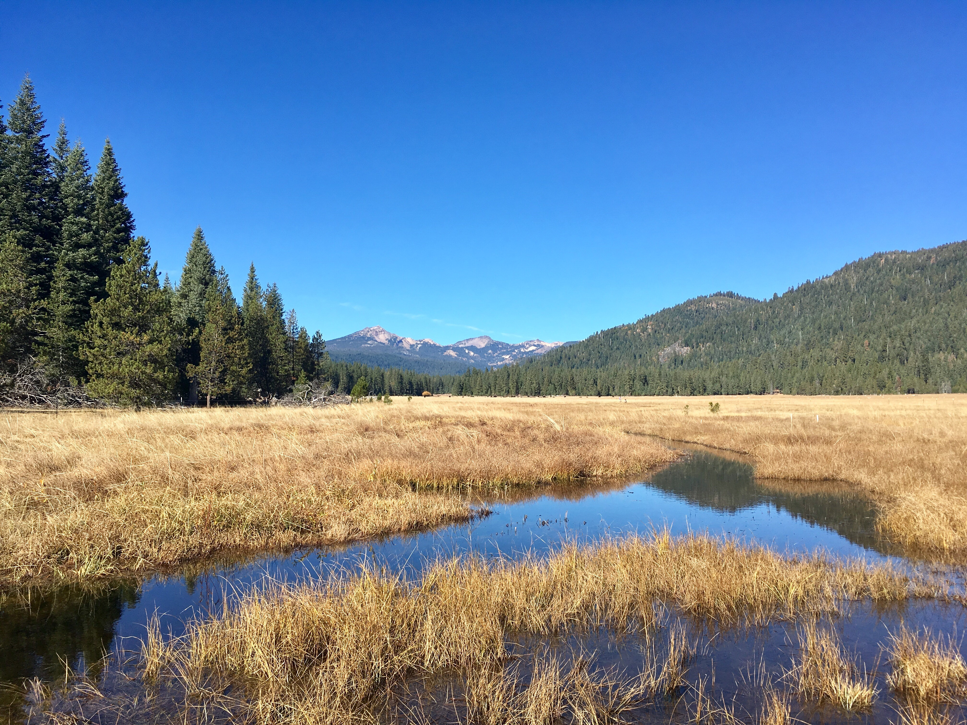
Crafting Climate-Smart Conservation Easements
Secure rights to restore, manage, and monitor resources
Link landowners to resources and technical assistance
TNC holds a CE over Childs Meadow with affirmative rights to conduct restoration, research, and monitoring.
Notes:
Example: Childs Meadow – TNC holds CE, affirmative rights to conduct restoration and research and monitor response of the meadow to restoration
Could also have mgmt. plans for working land CEs, landowner responsible for implementation, can include ecological monitoring to evaluate multi-benefits – soil carbon, water, wildlife
Link landowners to resources and technical assistance to do stew work
Example: MALT’s stewardship assistance program – link landowners with funding to do land mgmt. activities, link to NRCS, RCDs
Increase communication between land trusts and CE landowners, help link landowners to resources and technical assistance, collaborative relationship

Slide 7
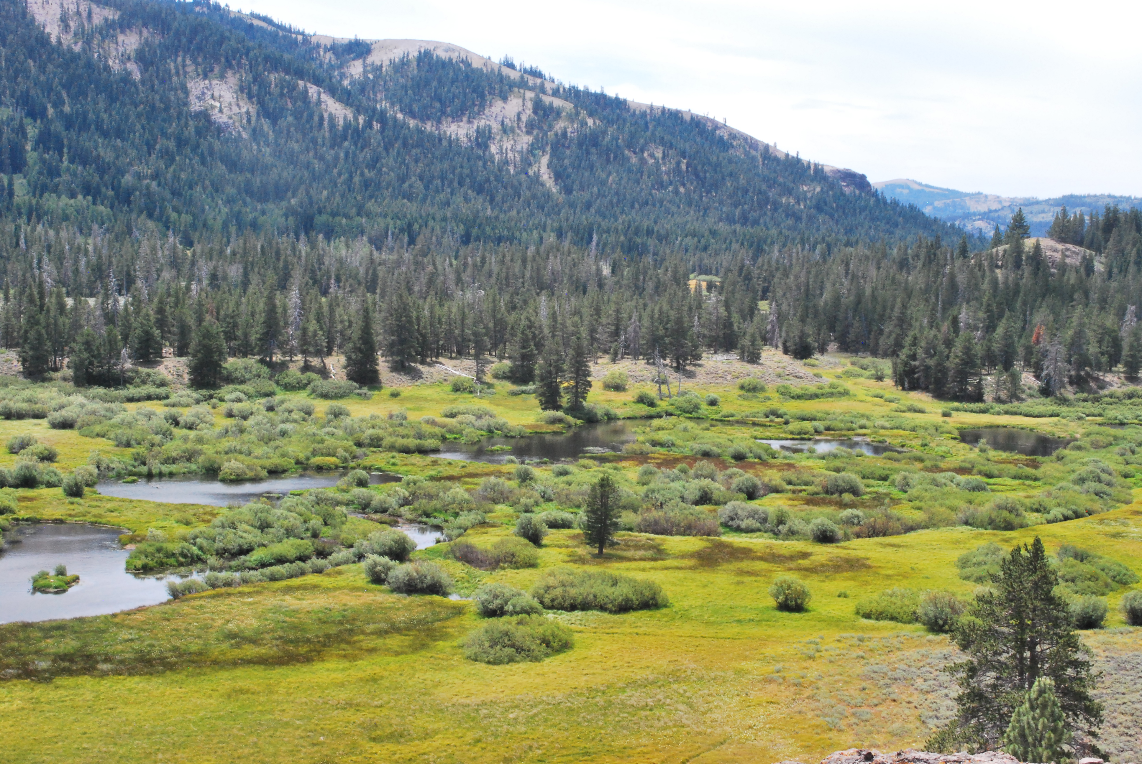
Stewardship and Restoration
Implement stewardship actions to reduce vulnerabilities
Addressing multiple stressors can increase resiliency
Protect conservation values in perpetuity
Meadow restoration catalyzed by land trust acquisition will increase carbon sequestration and water storage
Notes:
Stewardship is critical to address the threats and vulnerabilities posed by climate change
Vulnerability assessment for conservation values, identify adaptation actions
Stewardship activities don’t have to explicitly focus on climate change to be effective at addressing climate impacts
Addressing multiple stressors (invasive species, eroding roads, removing culverts) can help increase resilience of populations to climate change (Gillson et al. 20

Slide 8
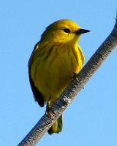
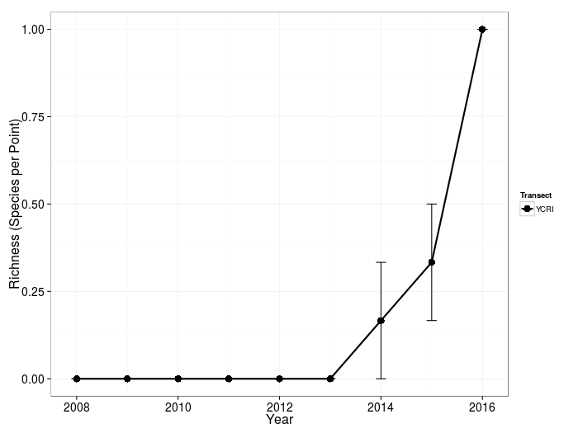
Monitoring and Evaluation
Monitoring helps identify threats AND evaluate success
Evaluate, learn, and adjust stewardship actions
Bird richness increases just 3 years post restoration
Yellow Creek in the Feather River
Notes:
In order to shape, test, and evaluate climate-smart stewardship actions, need monitoring
Monitoring helps evaluate how successful stew actions are at reducing vulnerabilities and addressing threats
Monitoring also helps identify climate stressors/threats to conservation values and then trigger stewardship actions to reduce vulnerabilities
13)
Treat mgmt. interventions as experiments, the outcomes of which are monitored and fed back into mgmt. (Gillson et al. 2013)
Example: we guide and monitor the outcomes of meadow restoration to inform long-term management
By monitoring meadow bird species richness after meadow restoration, we can evaluate if restoration actions were successful
Potential land trust acquisition CE

Slide 9
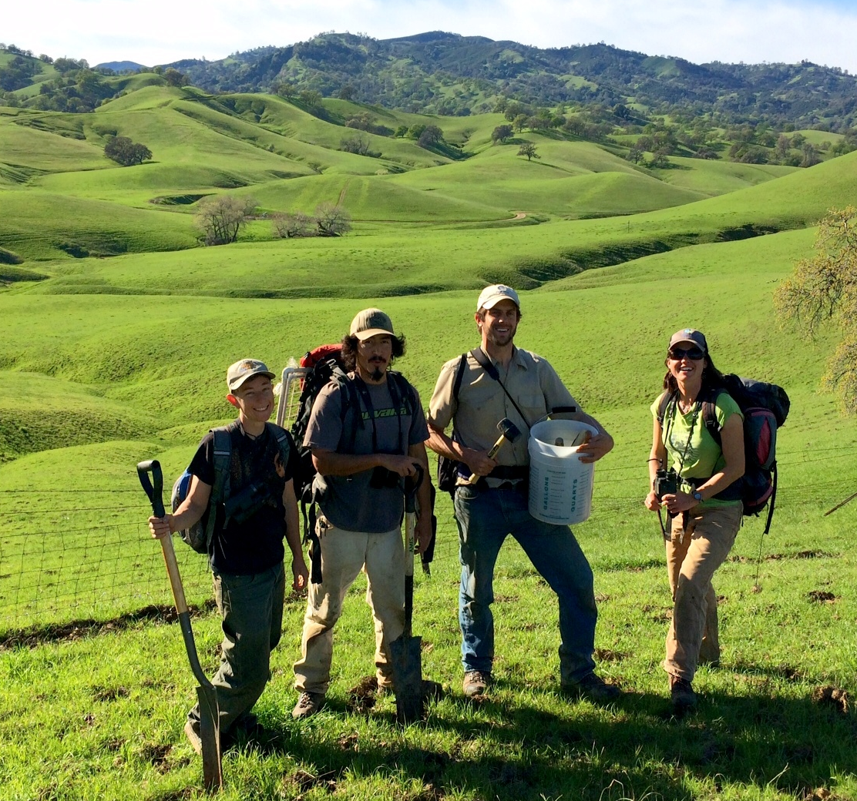
Catalyzing Climate-Smart Land Trusts
Work with land trusts to develop a framework that meets your needs and adds value to the important work you are already doing!
Notes:
Next steps:
Working with land trusts on each step to integrate climate change adaptation principles, this is a pilot program
Create framework aimed at land trusts
Pilot the framework with more land trusts
Disseminate broadly
Seeking feedback on approach

Slide 10
Thank you!
Marian Vernon
Sierra Meadow Adaptation Leader
Point Blue Conservation Science
mvernon@pointblue.org
Notes:
Meadow restoration catalyzed by Truckee Donner Land Trust
Purchased by TDLT and then handed over to the USFS for restoration
Perazzo
What resources do you need?
What challenges do you foresee?
What kind of assistance would be most helpful?

Slide 11
Why should your land trust care about climate change?
Impacts conservation values across landscape and future priorities
Need to adapt to ensure conservation values protected in perpetuity
4
Notes:
Threatens conservation values on existing protected land and across the landscape
Need to consider how to adapt to climate change to ensure our conservation values remain protected in perpetuity
Requires land trusts to use their superpowers of being nimble, quick, and flexible to respond to these changes!
Example: climate filter might change conservation priorities – habitat nodes, refugia, connectivity corridors
Example: land you want to protect might have increased wildfire risk
CE terms that can build in contingencies for climate change
Allow for restoration, land management actions that are adaptive
E.g. tree thinning, fuels reduction, even prescribed fire – think about CE terms and rights
Most importantly, land trusts make commitments to protect conservation values in perpetuity.
We need to honor our commitments and ensure that our conservation values persist in light of climate change and other emerging threats
Requires paying attention to the changes happening, designing and implementing stewardship actions to address vulnerabilities, and learn from the outcomes
Fire: Kent Porter, Sonoma mag, http://www.sonomamag.com/sonoma-county-wildfires-frequently-asked-questions-useful-numbers-and-resources/

Slide 12
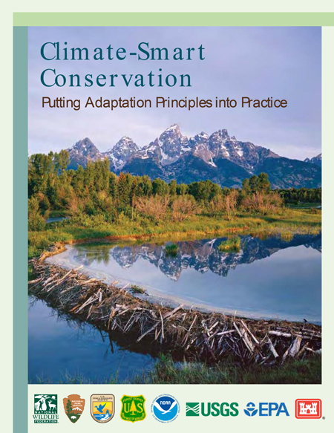
Introduction and Purpose
Introduce Point Blue’s work on climate-smart land trusts
Demonstrate how climate-smart principles can be adapted for land trusts
Get feedback on approach
Climate-Smart Land Trusts

